Slide 1
Astro 331 Lesson 7
Space Environment
Supp Crs Mtl, SMAD Ch 8

Slide 2
Lesson Objectives
List the six space environmental influences and describe what causes each of them
Describe the effects of each of the six space environmental influences on spacecraft, and describe strategies to mitigate those effects
Understand how the solar cycle impacts various space environment concerns
Understand how the Earth’s magnetosphere interacts with solar wind
Describe how the Van Allen radiation belt impacts spacecraft
Describe what causes the South Atlantic Anomaly (SAA) and what impact it has on spacecraft
Understand the terms “hardening” and “survivability” and how we achieve those in designing spacecraft

Slide 3
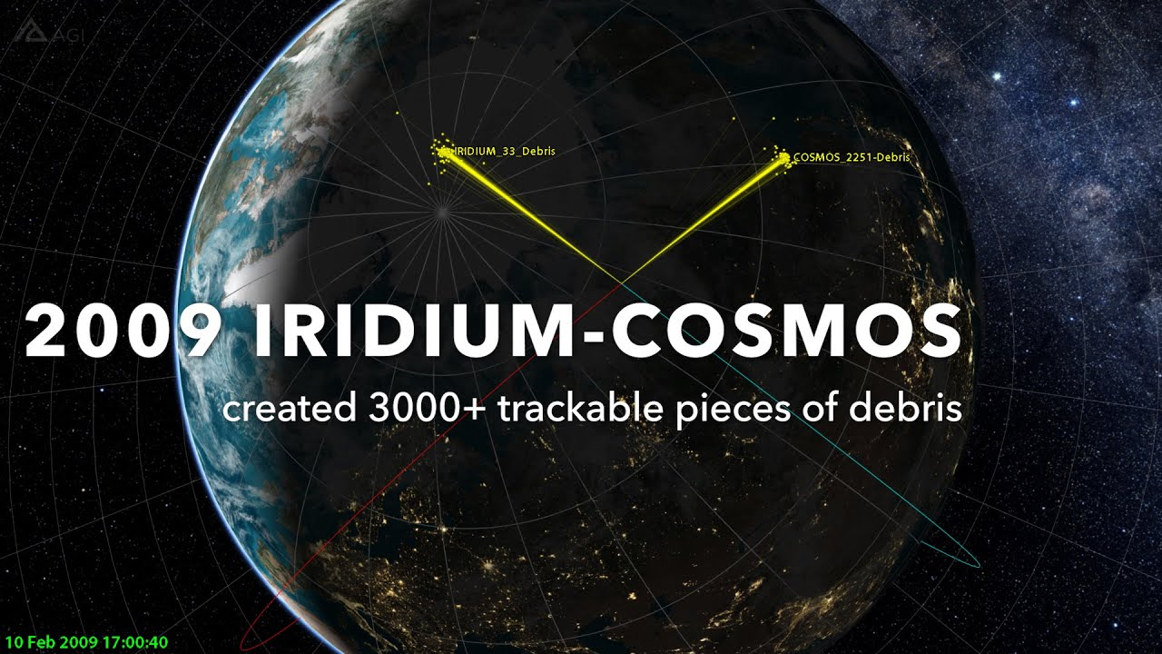
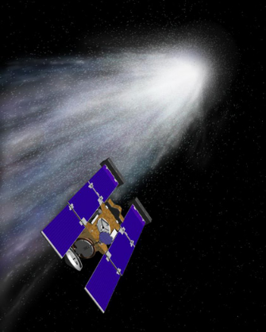
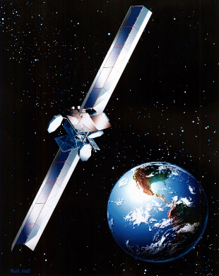
Why Worry about the Space Environment?
Approximately 25% of all spacecraft anomalies are related to the space environment. Famous examples include:
2010: Control of Galaxy 15 lost due to electrostatic discharge cause by solar flare. Satellite drifted through crowed GEO belt in full send and receive mode
2009: Iridium satellite destroyed when it collided with the dead Cosmos 2251 satellite (space debris)
2000: Boeing 702 satellite (Anik F-1): degraded solar array performance due to outgassing induced fogging
2000: Stardust comet flyby spacecraft blinded and sent into safe mode by a solar flare
1994: Telsat Canada’s Anik E-1 and E-2 suddenly began to spin out of control due to spacecraft charging
1990: High energy charged particles caused bit flips in HST fine guidance system electronics (FGS) passing through the South Atlantic Anomaly (SAA) causing guide star acquisition failures. Subsequently, FGS use was suspended in the SAA.
1979: Increased solar activity heated the outer layers of the Earth's atmosphere and thereby increased drag on Skylab, leading to an early reentry.
Warning- Traffic Hazard!. Iridium Collision with Cosmos 2251
Caution - Solar Flare. Stardust spacecraft was blinded by a solar flare
Beware - Outgassing. Anik F-1 degraded performance due to outgassing
Adapted from Designing Space Missions and Systems,
Teaching Science and Technology, Inc

Slide 4
Space Environmental Influences
Microgravity
Vacuum
Atmosphere
Plasma
Radiation
Micrometeroids & Orbital Debris

Slide 5
Microgravity
Source:
Spacecraft is in free fall, where it is continuously falling through space where the forward velocity of the spacecraft is enough to match the velocity that would pull the spacecraft back toward the Earth’s surface
Effects on spacecraft:
Fluid containment is a challenge
All articles must be secured
Allows uniform mixing of solutions
Allows opportunity for new manufacturing techniques
Strategies to mitigate effects:
Pressurize liquids/gases in containers
Secure all components

Slide 6
Vacuum
Source:
No air in space
Effects on spacecraft:
UV radiation causes coating and materials to degrade
Outgassing: spurious release of molecules that contaminate surfaces
Cold welding: unintended material bonding when the atmosphere between surfaces is absent
Strategies to mitigate effects:
Use coatings that protect against UV radiation and do not outgas
Vent propellant/gas away from sensitive surfaces
Don’t put metal objects that are vulnerable to cold welding near each other
Vacuum bake-out on ground

Slide 7
Atmosphere (1/2)
Source:
Uncharged particles in air around Earth
Effects on spacecraft:
Atomic oxygen: predominant atmospheric constituent from 200-600 km, forms when UV radiation dissociates molecular oxygen (Fig 8-5)
Atmospheric Drag
Strategies to mitigate effects:
Choose materials resistant to atomic oxygen or use protective coatings
Shield sensitive surfaces, design S/C with low coefficient of drag
Operate at higher altitudes if possible

Slide 8
Atmosphere (2/3)
Atomic Oxygen
Reacts with thin organic films, advanced composites and metallized surfaces
Degrades sensor performance
Weakens spacecraft structures
Density of atomic oxygen varies with the solar cycle
Solar cycle is periodic change in the amount of material and radiation emitted by the Sun and observed on Earth
Average of 11-year cycle; shortest was 9 yrs, longest 14 yrs
Solar maximum has many solar events; solar minima has almost no solar events
Solar flux varies substantially on a day-to-day basis and is difficult to predict at any given future time; however, average over an extended period is well known
Fig 8-1 depicts the F10.7 index, which is the mean daily flux at 10.7 cm wavelength in units of 10⁻²² W/m²·Hz

Slide 9
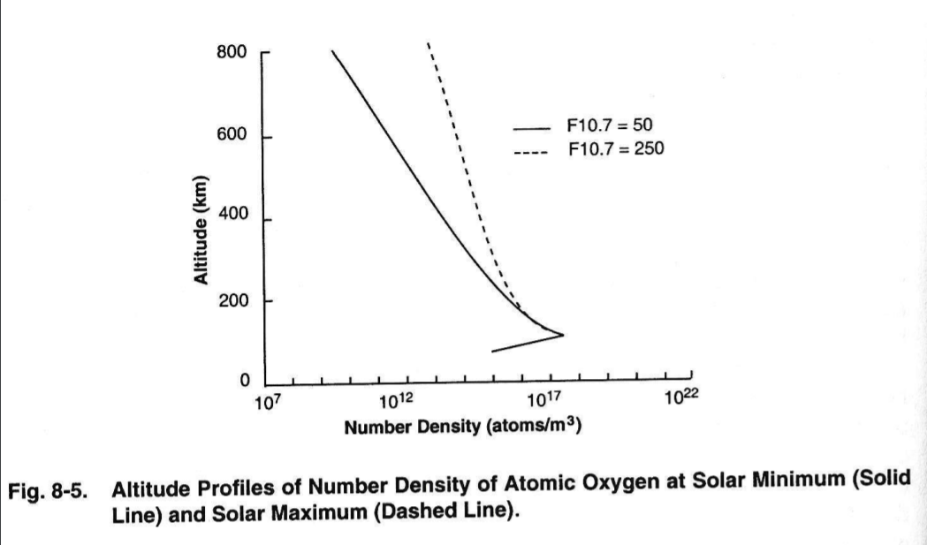
Atomic Oxygen

Slide 10
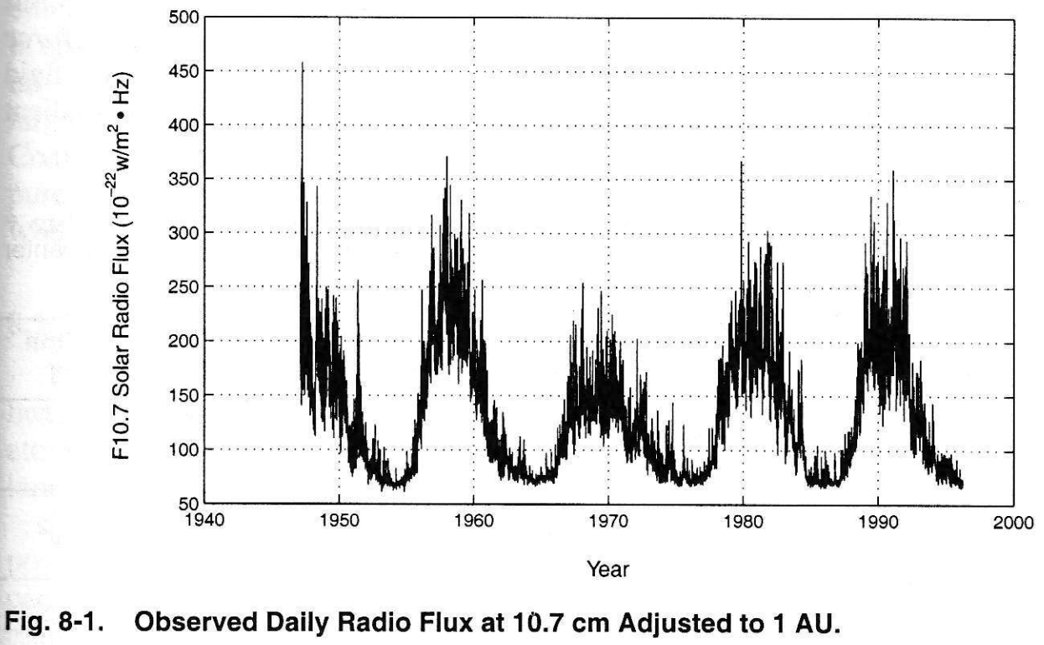
Solar Cycle

Slide 11
Atmosphere (3/3)
Atmospheric Drag
Depends on a variety of factors, including S/C ballistic co-efficient, speed and atmospheric density
Atmospheric density is highly dependent on solar cycle (Fig 8-2)
Thermosphere: (120-600 km altitude), region where absorption of extreme UV radiation results in rapid increase in temperature with altitude
Heating due to EUV radiation and solar cycle variation impacts atmospheric density and has the greatest effect on satellite lifetimes

Slide 12
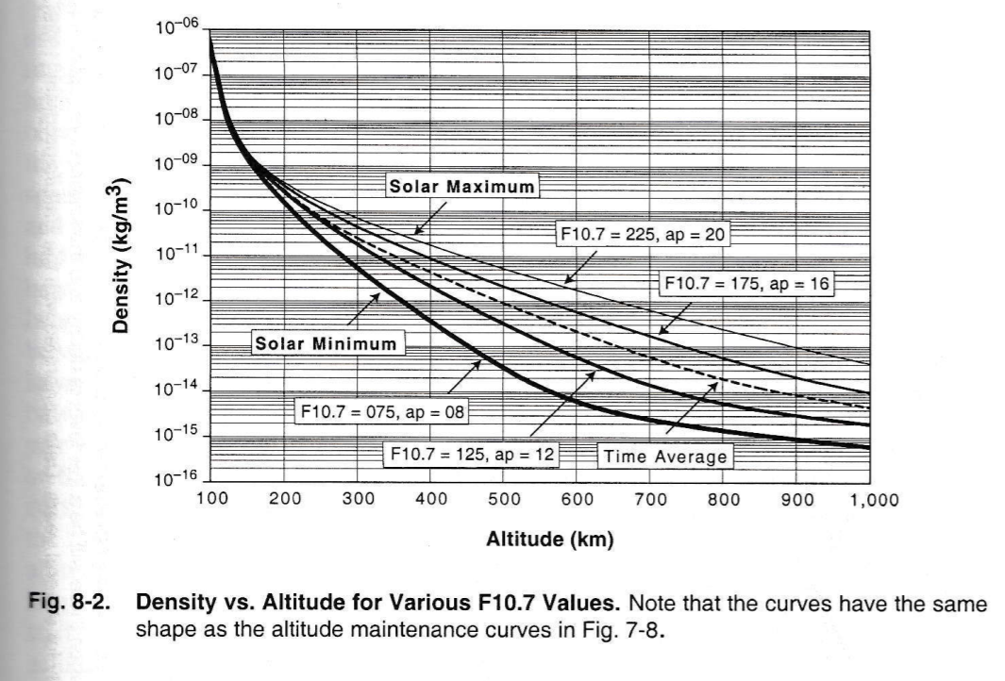
Impact of Solar Cycle on Atmospheric Density

Slide 13
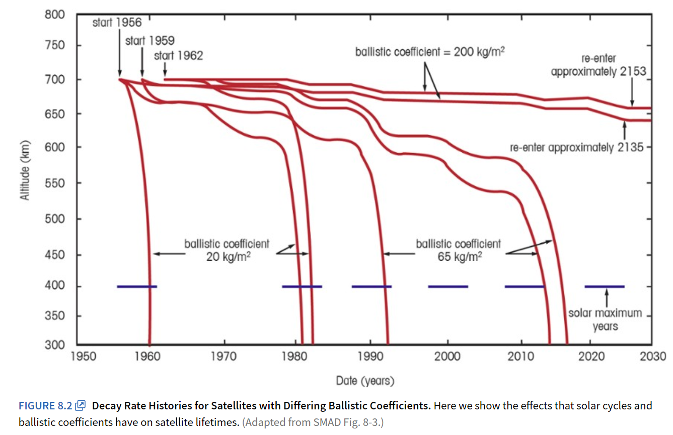
Impact of Solar Cycle/Ballistic Co-efficient on Satellite Lifetimes

Slide 14
Plasma (1/2)
Plasma consists of neutral particles, positive ions, and electrons
The most abundant matter in the universe (99% of universe mass)
Source:
Formed from interactions between solar wind and Earth’s magnetic field, stretches into long structure known as the magnetotail
Can also come from solar flares or galactic cosmic rays (GCRs)

Slide 15
Plasma (2/2)
Effects on spacecraft:
Energized plasma (particles with energy from 5 keV to 50 keV) can extend into geosynchronous orbits, charging the surface of any spacecraft to high negative voltages
Electrostatic arcs can cause electromagnetic interference (EMI) on spacecraft, causing erratic behavior
Surface Charging that impacts spacecraft operations occurs in orbits where electrons with energies of 10-20 keV dominate the electron current
At low altitudes, this occurs only at high latitudes (where auroral electrons collide w/ vehicle)
At higher altitudes, surface charging occurs during magnetospheric substorms
Ion drag that adds to orbital decay
Ion sputtering that increases surface erosion
Strategies to mitigate impacts:
Prevent differential charging of surfaces by ensuring entire surface is made of a uniform conductivity
Balance currents using special surface coatings
Grounding, selecting insulating surface materials, shielding, filtering, proper handling procedures

Slide 16
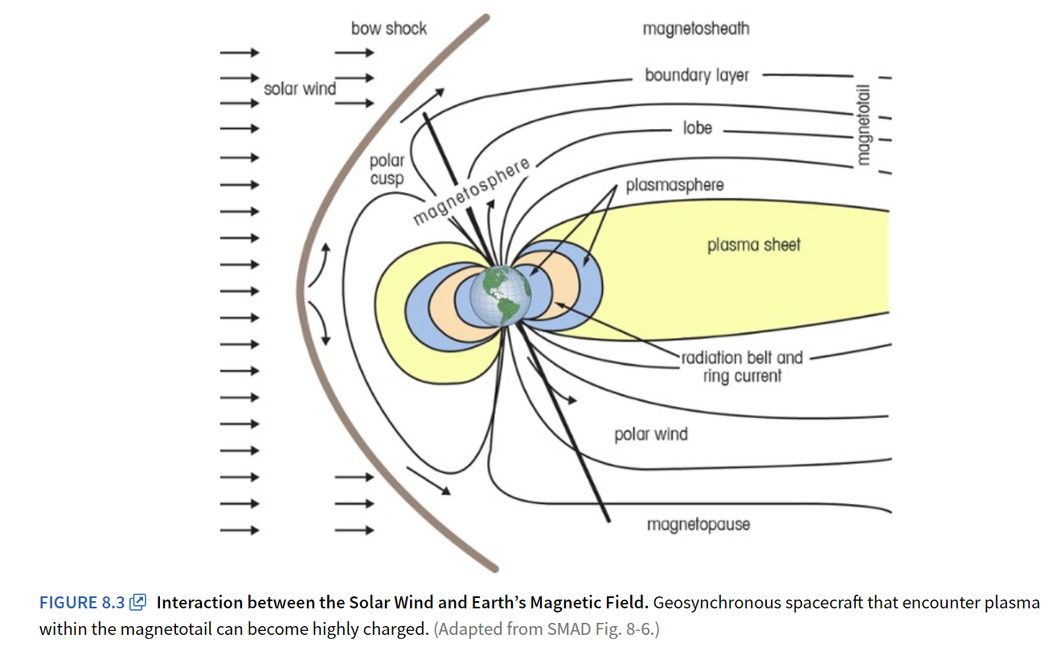
Earth’s Magnetosphere

Slide 17
Radiation
Sources:
Galactic Cosmic Rays (GCRs) are high-energy particles from outside the solar system
Solar Particle Events (SPEs) when large amounts of particles are spewed from the Sun
Van Allen radiation belts
Effects on spacecraft:
Can cause Single Event Phenomenon (SEP), which can have three effects:
Bitflip/Single Event Upset (SEU) – changes one bit
Single Event Latch-up (SEL) – part hangs up, draws excessive current, will not operate until power cycled
Single-Event Burnout (SEB) – causes device to fail permanently
Can generate background noise and produce spurious signals in various sensors
Strategies to mitigate impacts:
Shielding sensitive electronics
Design and parts selection (use radiation tolerant parts)
Redundancy
EDAC (error detection and correction – more to come on this in the TT&C lesson)

Slide 18
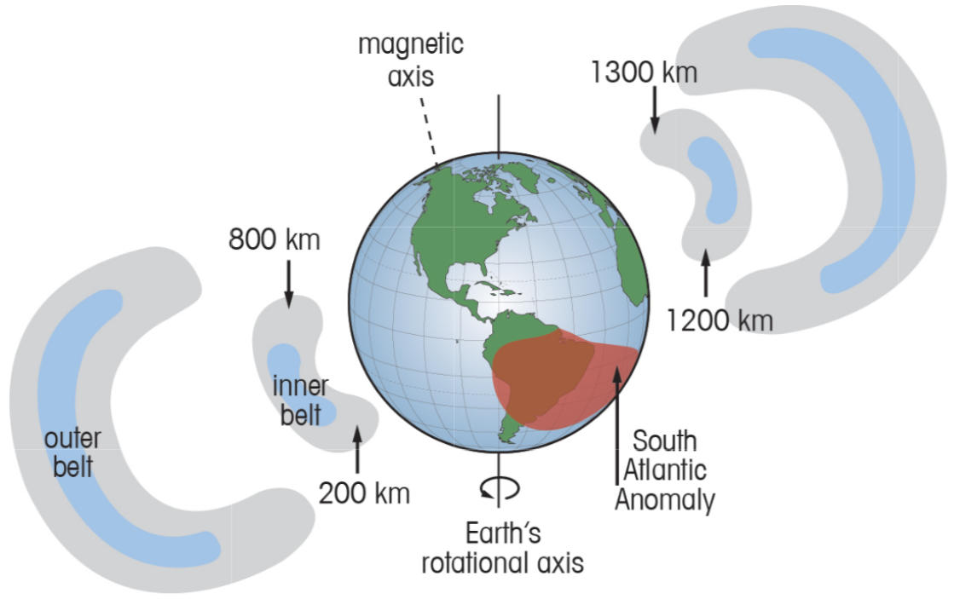
Van Allen Belts
Designing Space Missions and Systems, Fig 8.5

Slide 19
Van Allen Radiation Belts
Regions of high-energy particles, mainly protons and electrons, held captive by Earth’s magnetic influence
Permanent hazard to orbit spacecraft, with particles distributed non-uniformly with Earth’s magnetosphere
South Atlantic Anomaly is a volume of space centered on South America’s east coast, where Earth’s inner Van Allen belt comes closest to the surface due to a weakness in Earth’s magnetic field
An increased flux of particles exists within this space and exposes spacecraft to higher than usual radiation levels

Slide 20
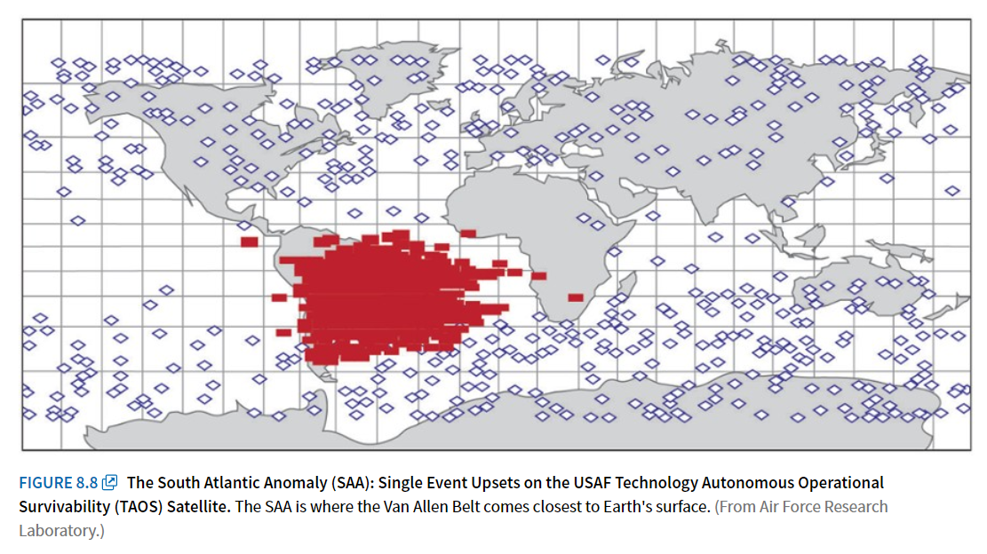
South Atlantic Anomaly

Slide 21
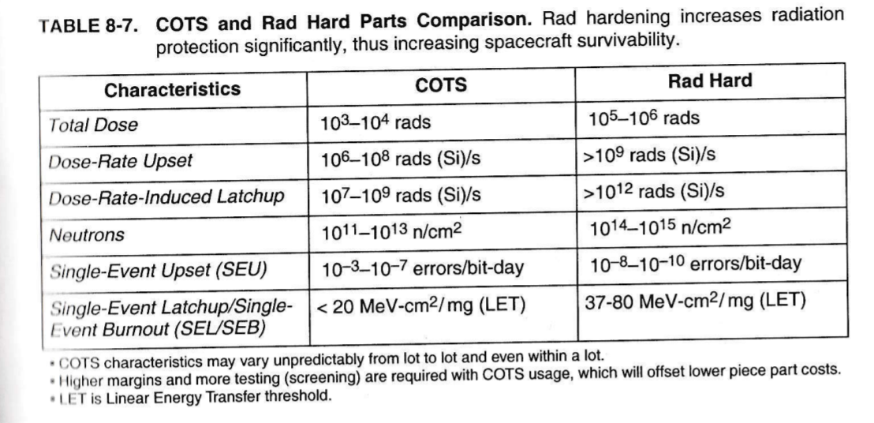
COTS vs Rad Hard Parts

Slide 22
Micrometeoroids and Orbital Debris (MMOD)
Source:
Defunct spacecraft, rocket bodies and spacecraft debris are still in orbit and are not controlled
Effects on spacecraft:
Potential for collision
Strategies to mitigate impacts:
Choose orbits with minimal debris (if possible)
Have additional propellant on-board for collision avoidance maneuvers
Plan to dispose of spacecraft at end of mission life

Slide 23
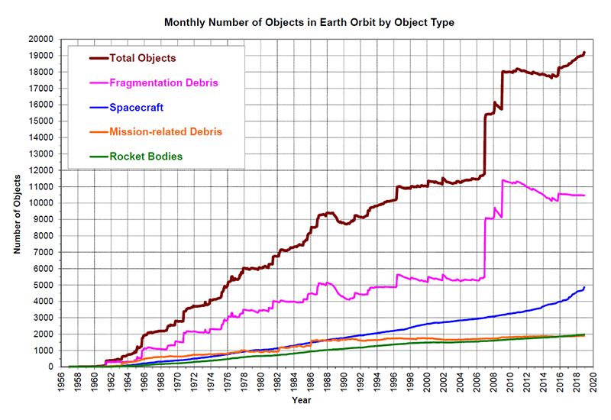
Orbital Debris
Source: NASA Orbital Debris Program Office

Slide 24
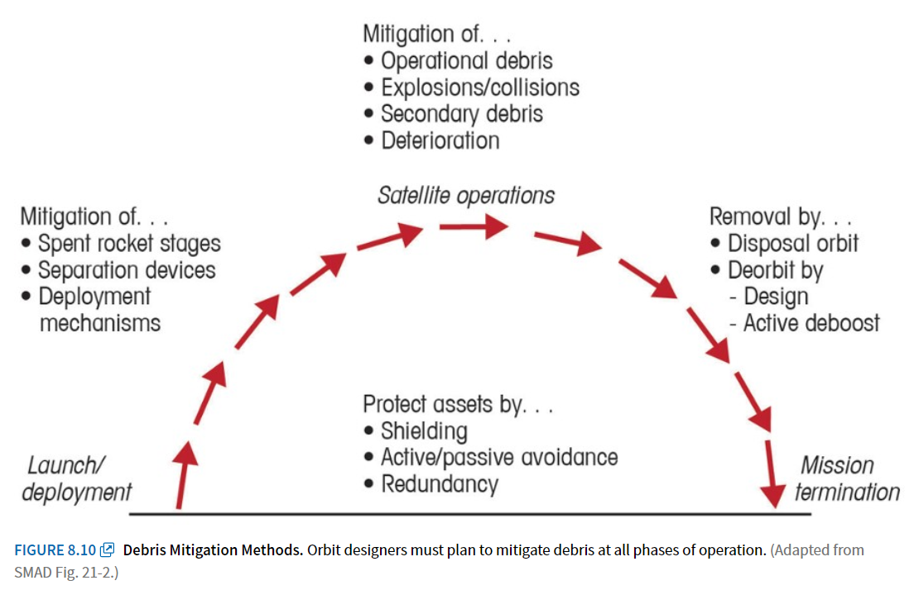
Debris Mitigation

Slide 25
Hardening
Design choice when building a space system to mitigate the negative impacts of the space environment or potential hostile action (eg: shielding, filtering, etc)
Survivability
Ability of space system to perform its mission after being exposed to a stressing environment or hostile action

Slide 26
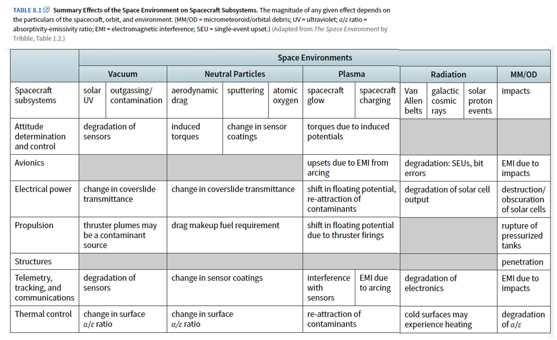
Space Environment (Key Takeaways)

